Slide 1

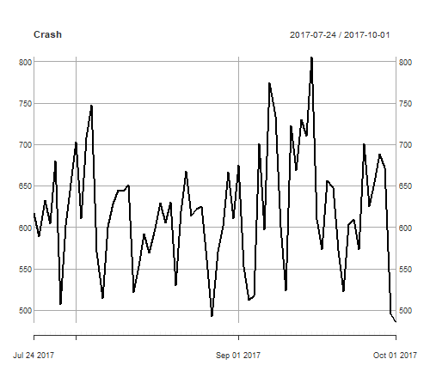
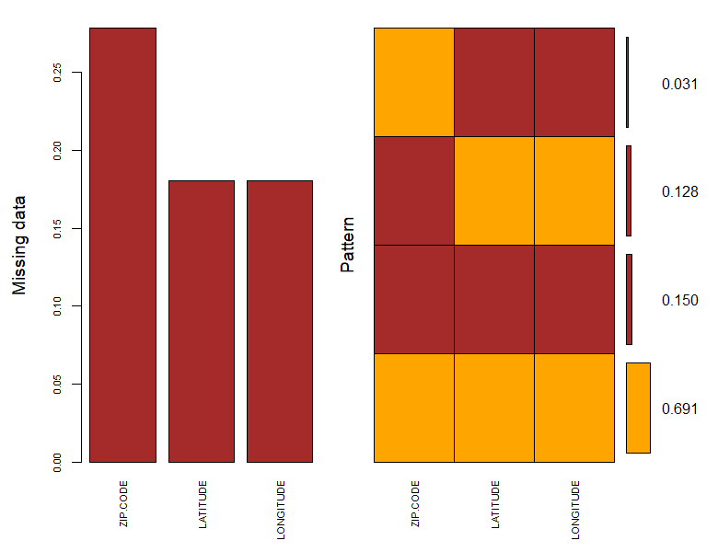
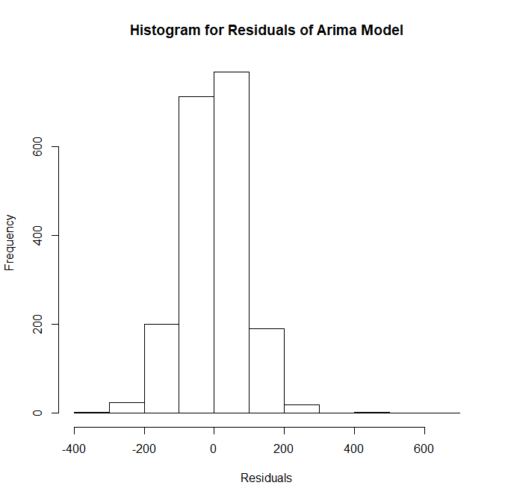
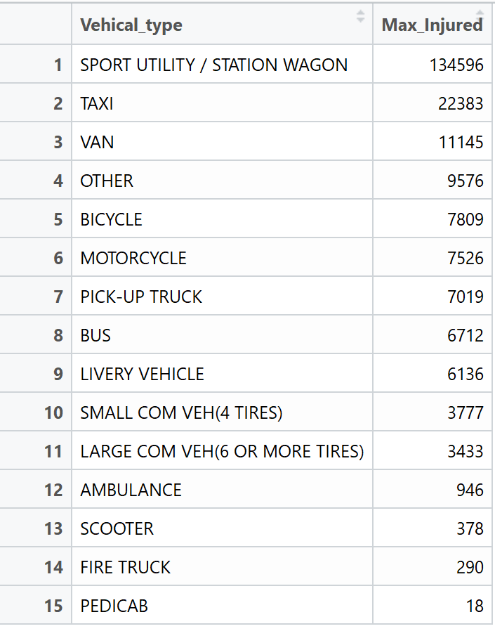
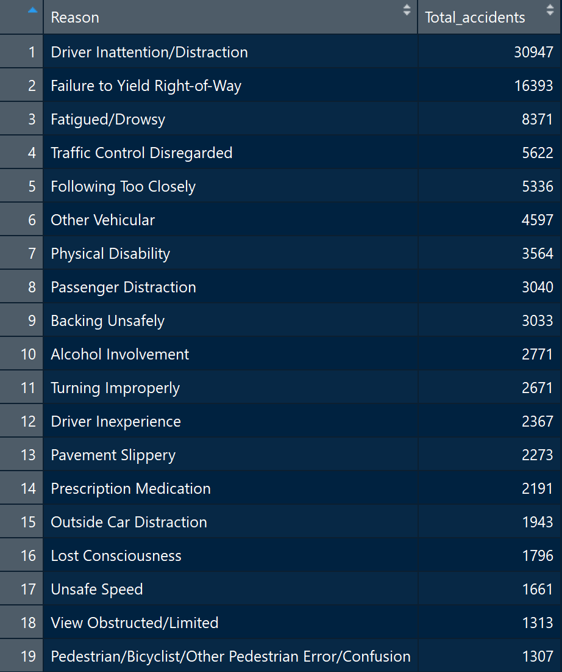
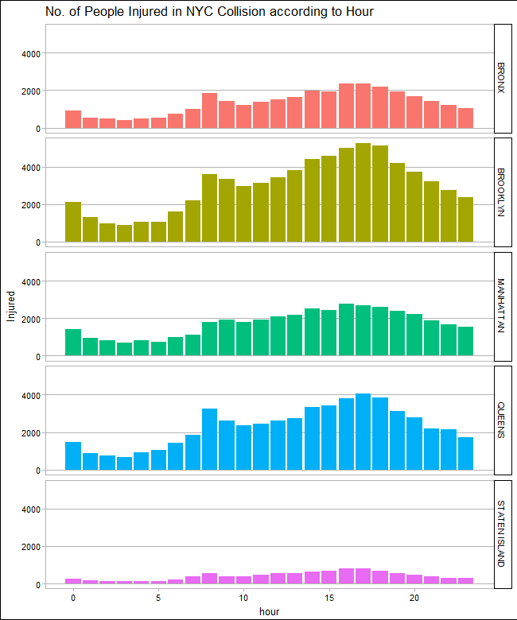
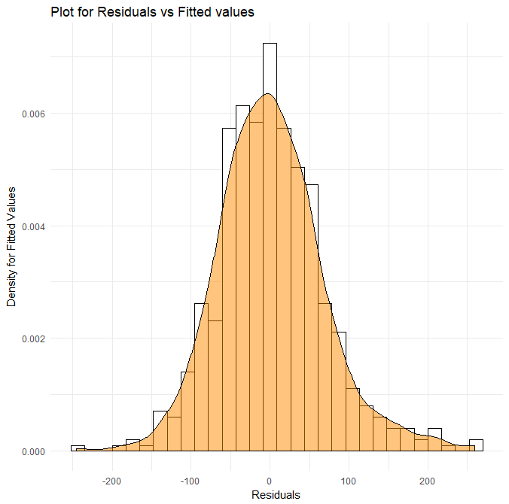
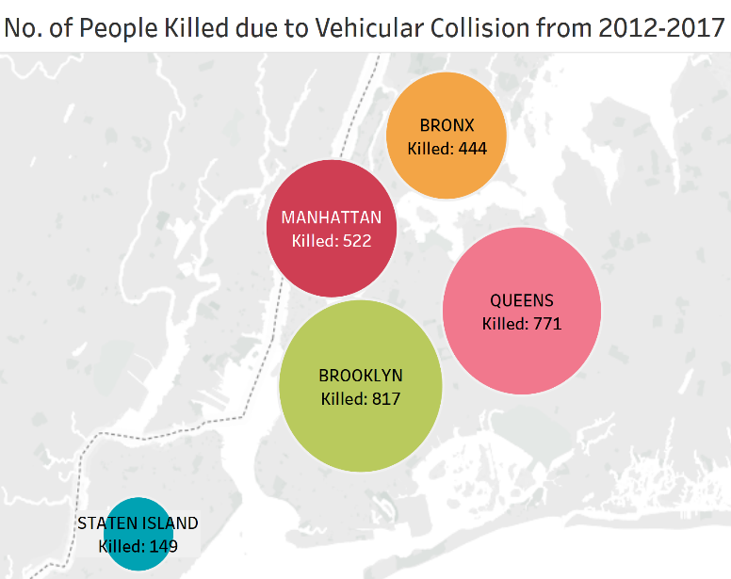
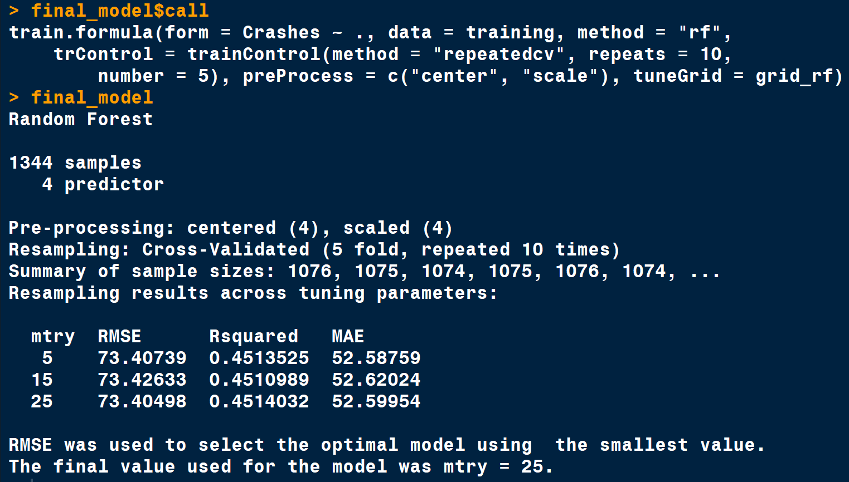
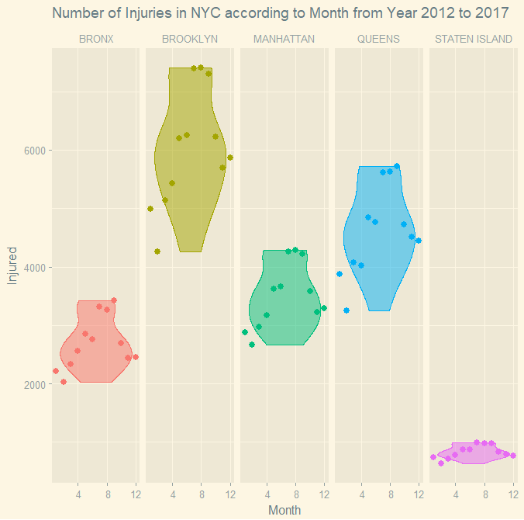
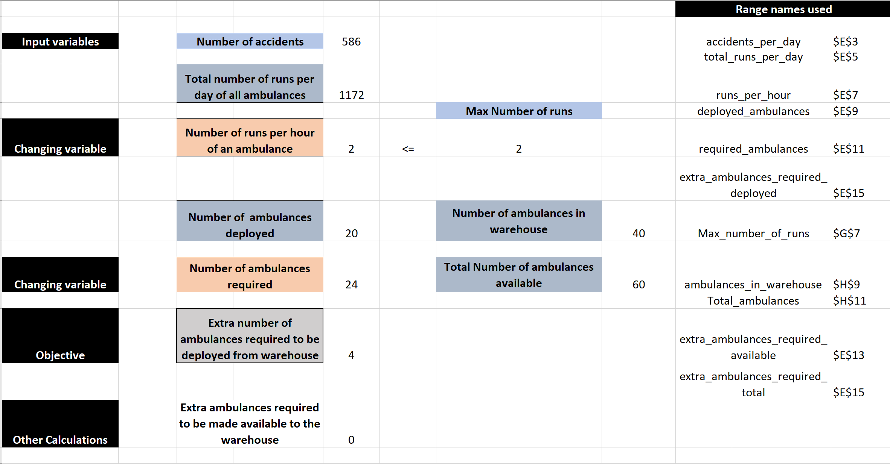
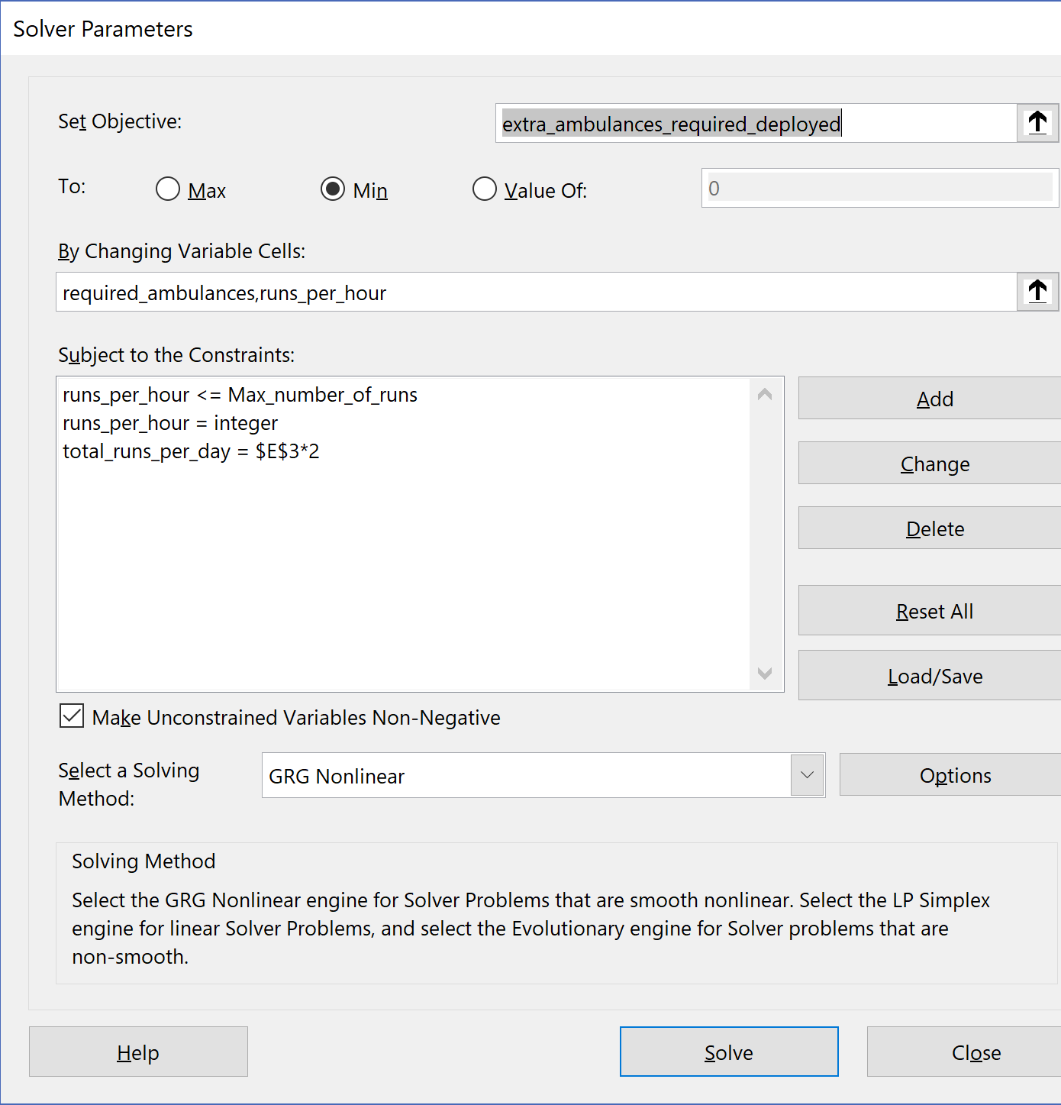
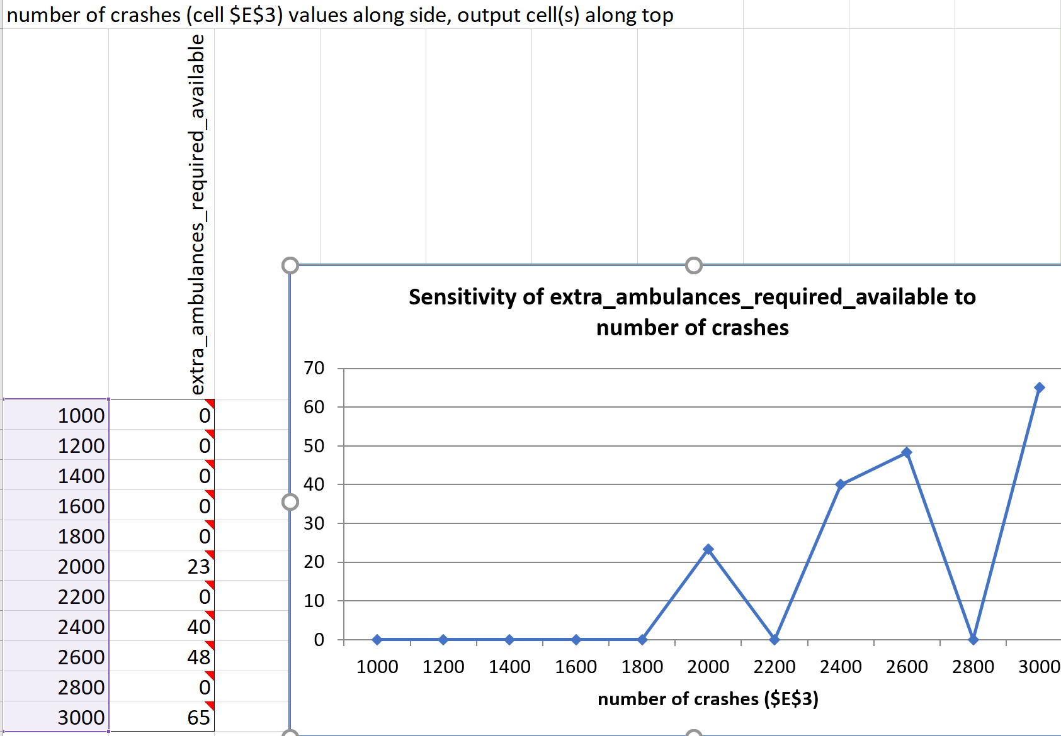
Predicting Vehicle Collisions & Dynamic Assignment of Ambulances in NYC Divya Rathore, Dhaval Sawlani, Nitasha Sharma, Shruti Tripathi Instructor: Ted Stohr
Business Intelligence & Analytics
Introduction
Historical data about vehicle collisions indicates that an average of 586 collisions happen in New York City every day. These incidents have increased the demand for emergency services in the city.
In order to meet these demands, we predict the No. of collisions that would happen in the city on a specific day with the help of machine learning techniques such as Random Forest & Statistical Methods such as ARIMA modelling. We then optimize the number of ambulances the City would require to provide satisfactory services.
A typical model of collisions in NYC is shown here.
Data Understanding
& Cleaning:
The Data set has 1.1 Million rows and 29 Variables. The features had a lot of missing values.
The following plot helps visualize the trend in missing values for location variables.
While 70% of this data is completely filled, 30% of it is completely or partially empty. Dropping these values will cause loss of information and hence we Impute the Missing Data with the Help of the MICE package in R using Predictive Mean Matching i.e. PMM.
The analysis focused on the casualties that happened as a result of vehicle collisions because of which entries where nobody was injured or killed were dropped in order to extract relevant data.
Predictive Modeling
The vehicle collisions were treated as a Time Series and ARIMA modelling was performed. The Arima model had a (AR) of order 1, (I) i.e. Integrated of 0 which states that the data was Stationary & (MA) of 1. These values where obtained by diagnostic approaches and where found to be optimal considering the AIC of the models. The histogram for residuals vs fitted for ARIMA model is as follows. The graph is a Normal Bell curve and hence is a sign that the model is performing well.
To confirm this, a Random Forest was fitted on the data. Variables such as Day, Month, Year & Weekday where taken as the independent variable and Number of Collisions happening was taken as the Dependent variable. The Histogram for the Residuals for Random Forest was also a normally distributed bell curve indicating that the model was performing better.
Comparing the two models, The Random Forest performed better than Arima in explaining the Variance and thus was selected to be our final model.
Exploratory Data
Analysis:
STAGE 1:
The top 20 reasons that caused Maximum Injuries & Crashes have been summarized in the following two Tables. We are able to say that the Vehicle causing maximum Injuries is the SUV followed by TAXI & VAN. Also, Driver Inattention/Distraction caused maximum Collisions.
STAGE 2:
The timeline of injuries caused in NYC are plotted borough wise across the 5 boroughs of New York City. We find that Maximum Injuries are caused between 10AM to 5PM
STAGE 3:
Number of People Killed from 2012 – 2017 are mapped across five boroughs of NYC.
STAGE 4:
This plot beautifully illustrates the Density Distribution across the Five Boroughs of NYC, visualizing the Number of People Injured from 2012 – 2017. We find that Brooklyn had maximum Injuries. Also, the distribution suggests that the months from May to September led to maximum Injuries.
Optimization Model
Prediction from our Random Forest Model is used as the Input data for our Optimization Model.
From the EMS monthly report, we estimate the number of ambulances that would be required for vehicle collisions & dynamically pick a value of 20 ambulances that have already been assigned. With the help of the Solver function in Excel, we model the Number of Ambulances that should be deployed and the number of additional ambulances that should be made available to the Ambulance Station in order to provide satisfactory results. The sensitivity analysis shown here depicts how the requirements for ambulances varies with the change in number of crashes. A snapshot of our Excel Model is as follows. This Dynamic nature of our model can be implemented in the real world if we can obtain the exact number of Ambulances that have been allocated in NYC for Vehicle Collisions.

